Slide 1

GDV4000 Introduction to Games Industry Practice.
Design Fundamentals

Slide 2
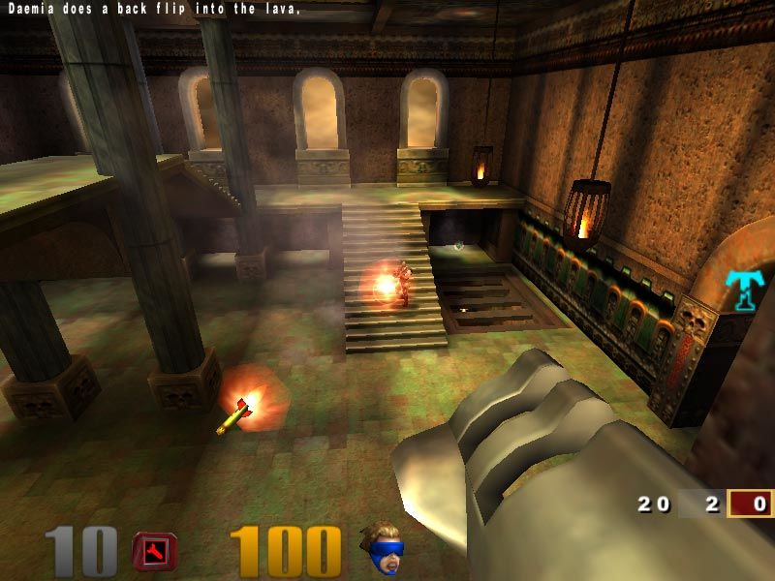
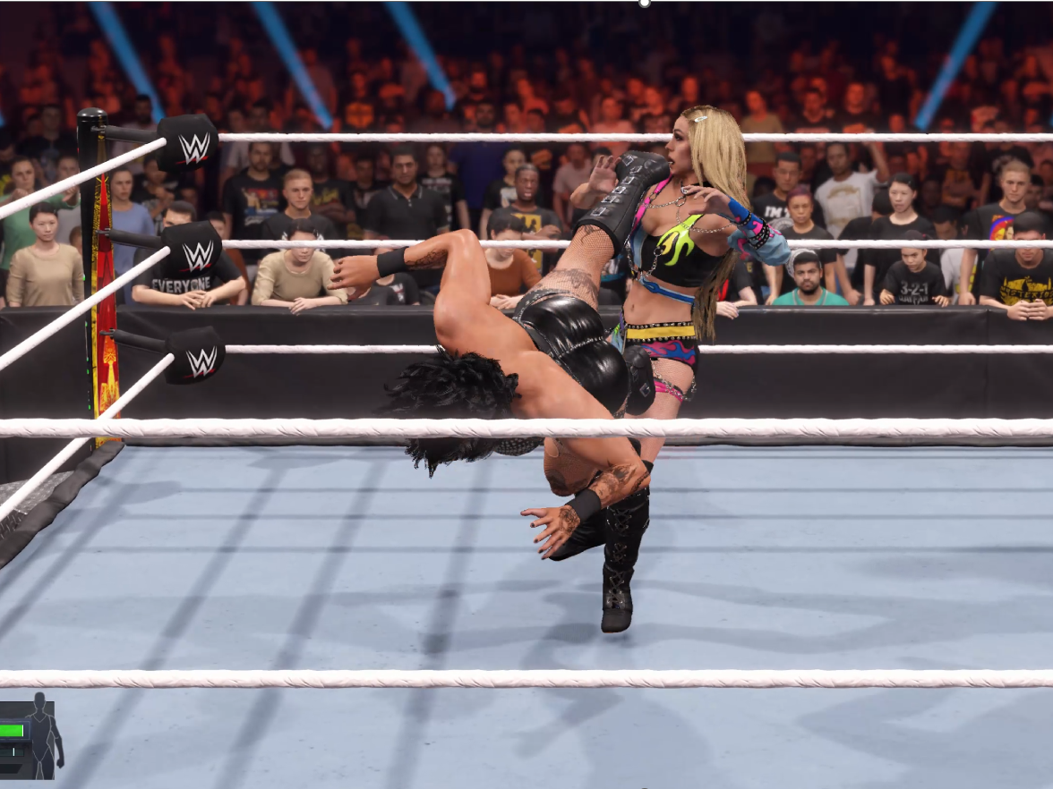
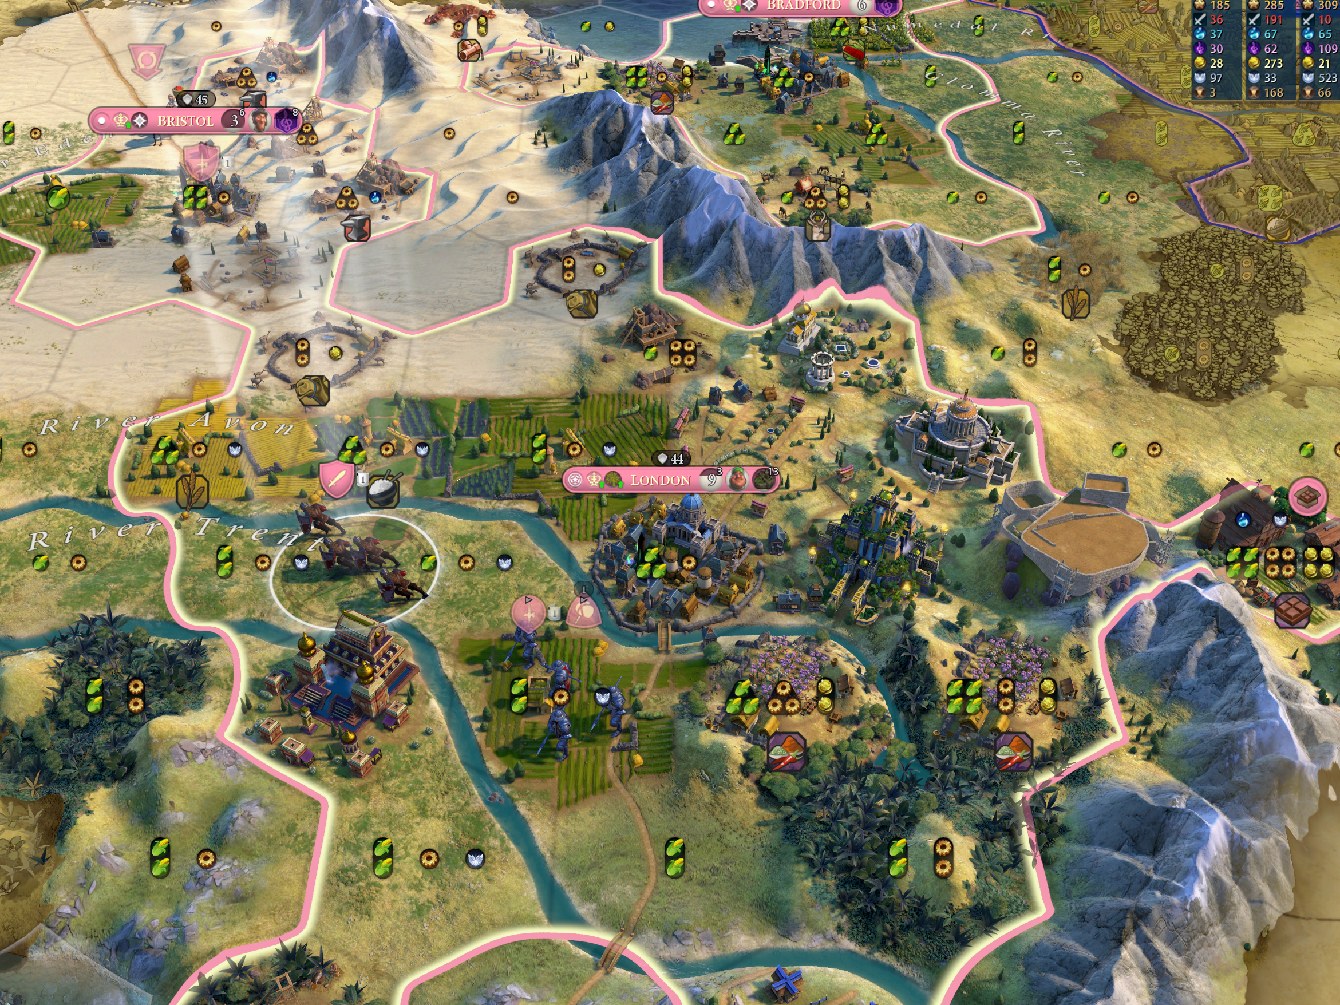
The Core Experience
“Quake III Arena” © Id Software
“WWE 2K24” © 2K/ Visual Concepts
“Sid Meier’s Civilisation VI” © Firaxis Games
Understanding the Core Experience of your game – both overall and the component parts. Be mindful of how the player is interacting and responding to your game…
Consider – Is it as much fun to play as a referee or a manager as it is to wrestle in “WWE 2K25”? It’s a different experience within the game, but it ought to be fun to do.
Are all the civilisations in “Sid Meier’s Civilisation VI” balanced enough to provide a fun but challenging experience, without any ‘Civs' being overpowered?

Slide 3
The Core Experience
How does that translate in game?
Identify what the game is and stick to it – Game Design Document.
Build mechanics that support the game.
How will your player interact with your game?
How does the game make them feel? Is it fun? Is it immersive?
Test and test and test!

Slide 4
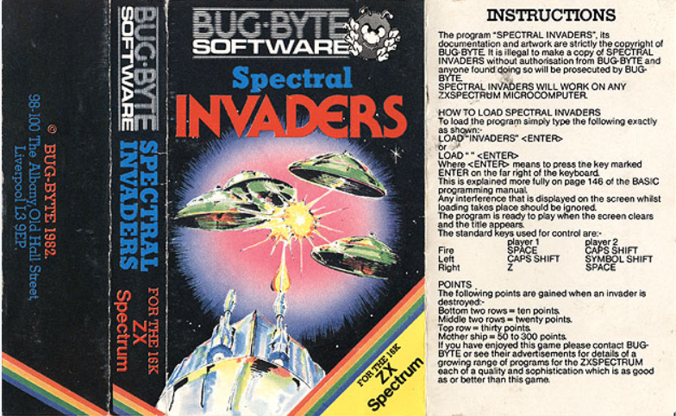
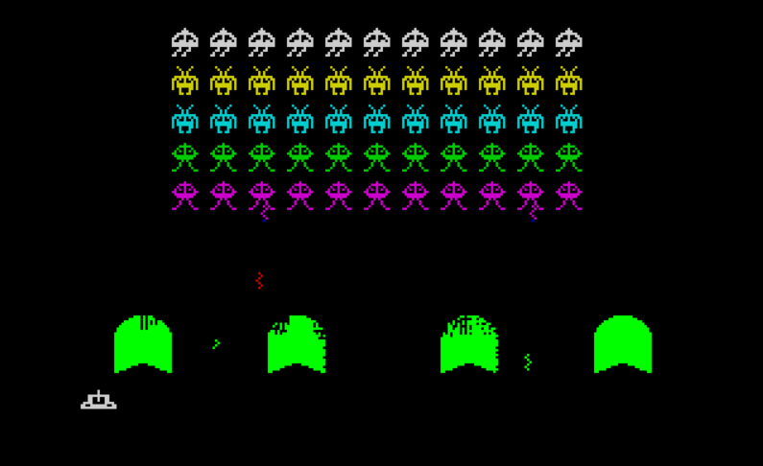
What back story??
Space Invaders (or cheekily renamed variant) needed little explanation. Instructions were on the back of the cassette, and as soon as it (eventually) loaded and you got into the game, you could move left and right and shoot by pressing the fire button. Shooting would destroy the advancing enemy ships and add to your score on-screen. Everything that was needed to know was being directly relayed back through the actions of the player.
Screenshots taken from World of Spectrum

Slide 5

Looking at you, Skyrim…
If we are giving our player options as part of the experience of playing our game, how are we balancing those out?
Is there a particular weapon that is being favoured during testing? Why is that?
Testing is crucial!
“Feedback is fact insofar as it reveals how our game makes people feel, but after that, it’s our job to come up with the right solution to that problem” – Sid Meier (2020, p. 248)

Slide 6
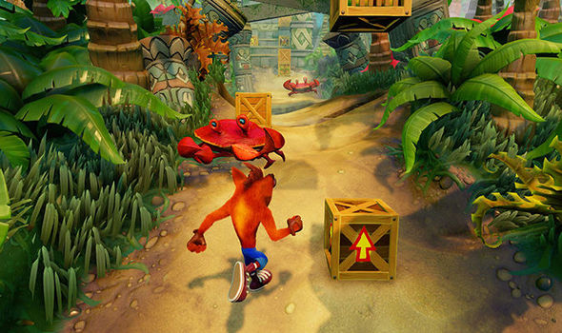
Implement the Core Game Experience Early On
This is a fundamental rule and can save you so many problems later.
What is the game you are making?
What are the Core Mechanics driving the game?
Are the objectives clear to the player without needing to be explained?
Communicate ideas, changes, and iterate until it’s right!
Get feedback from people outside your group – How you think your games plays may be very different to how it is interpreted from outside your dev team.
Note – Clear direction of travel and boundaries. Crates are marked to denote the different usages and abilities they transfer to the player.
“Crash Bandicoot” © Naughty Dog
Note – We have spoken of our game and this idea of experience, but they are not the same thing.
The game is not the experience; the experience comes from the game…

Slide 7


A word from Game Designer Jesse Schell…
From ‘The Art of Game Design: A Book of Lenses’
“The game is not the experience. The game enables the experience, but it is not the experience. This is a hard concept for some people to grasp. The ancient Zen question addresses this directly:
“If a tree falls in the forest, and no one is there to hear it, does it make a sound?”
This has been repeated so often that it sounds hackneyed, but it is exactly what we are talking about. If our definition of “sound” is air molecules vibrating, then yes, the tree makes a sound. If our definition of sound is the experience of hearing a sound, then the answer is no, the tree makes no sound when no one is there. As designers, we don’t really care about the tree and how it falls—we care only about the experience of hearing it. The tree is just a means to an end. And if no one is there to hear it, well, we don’t care at all.”
Schell (2020) p.11

Slide 8
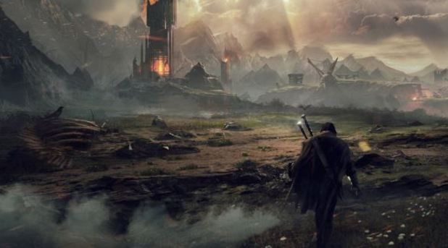

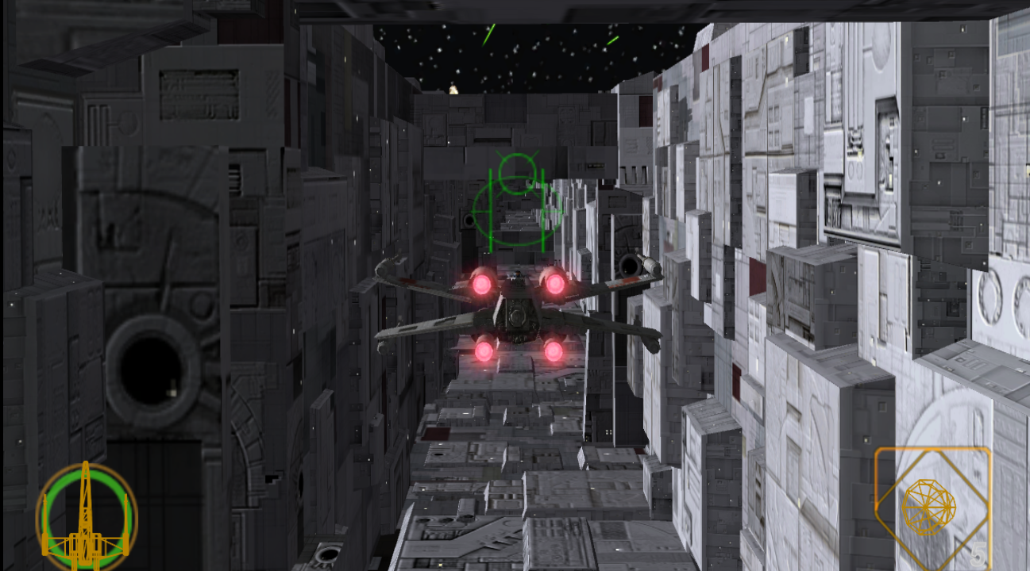
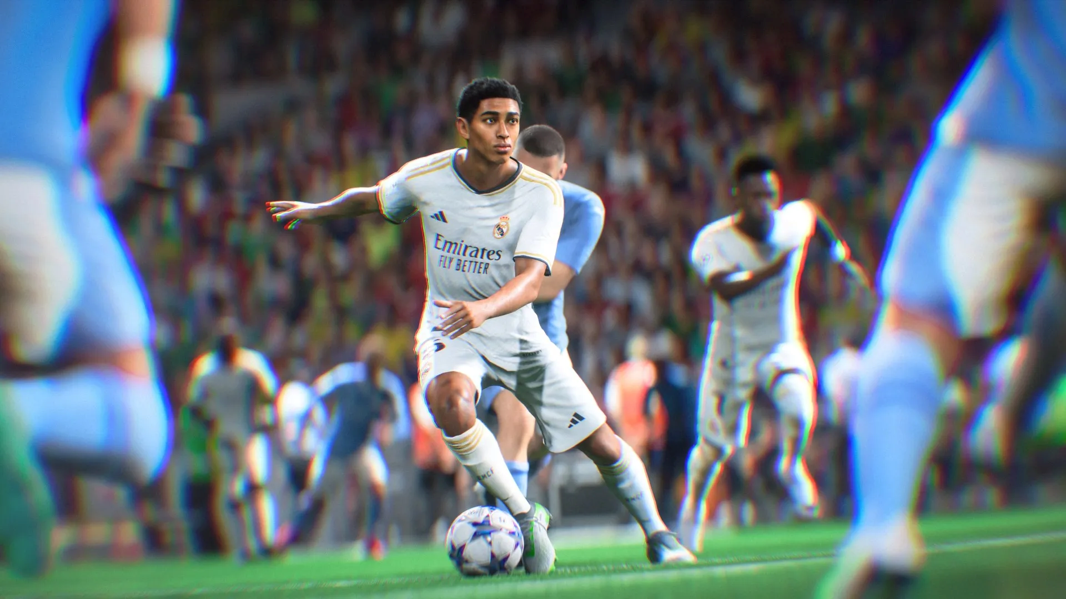
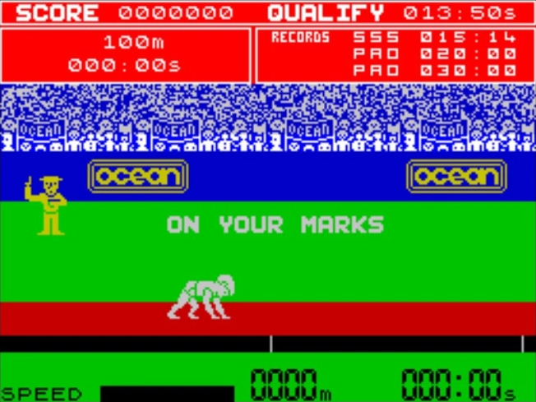
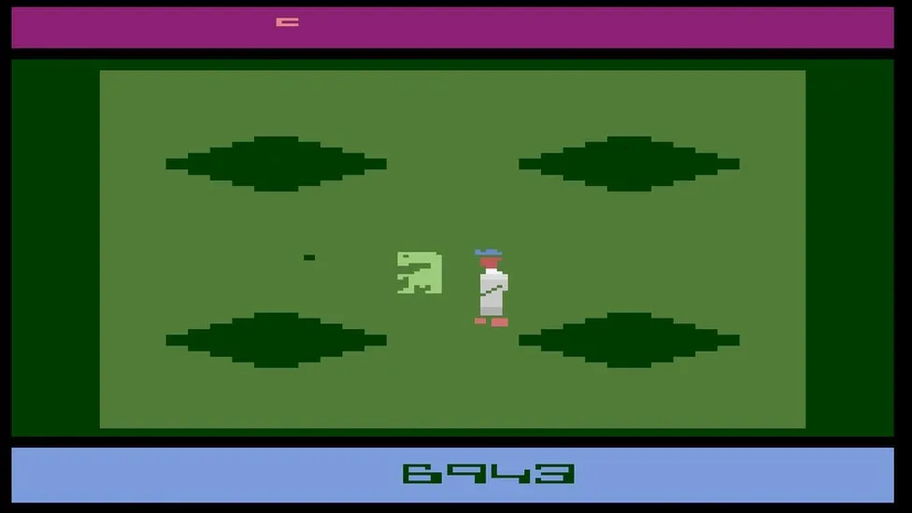
What is the appeal?
Who is your game targeting? Why will people want to play your game?
Some titles are tied to Intellectual Properties, owned by film studios, which present the player with a world and characters they may know from other media.
It could also be an art style, a unique or interesting game mechanic (‘Viewfinder’, ‘Portal’), an open-world experience (‘Elden Ring, ‘Elder Scrolls V: Skyrim’).
“Shadows of Mordor” © Monolith Productions
“Star Wars Rogue Squadron II: Rogue Leader” © Factor 5/Lucasfilm Games LLC
Beyond the Star Wars setting, part of the appeal of Rogue Squadron II: Rogue Leader was being able to take part in the Death Star Run from ‘Star Wars Episode IV: A New Hope’.
“FC 24” © EA
“Daley Thompson’s Decathlon” © Ocean
“E.T. The Extra-Terrestrial” © Atari. Images from Hooper (2016)

Slide 9
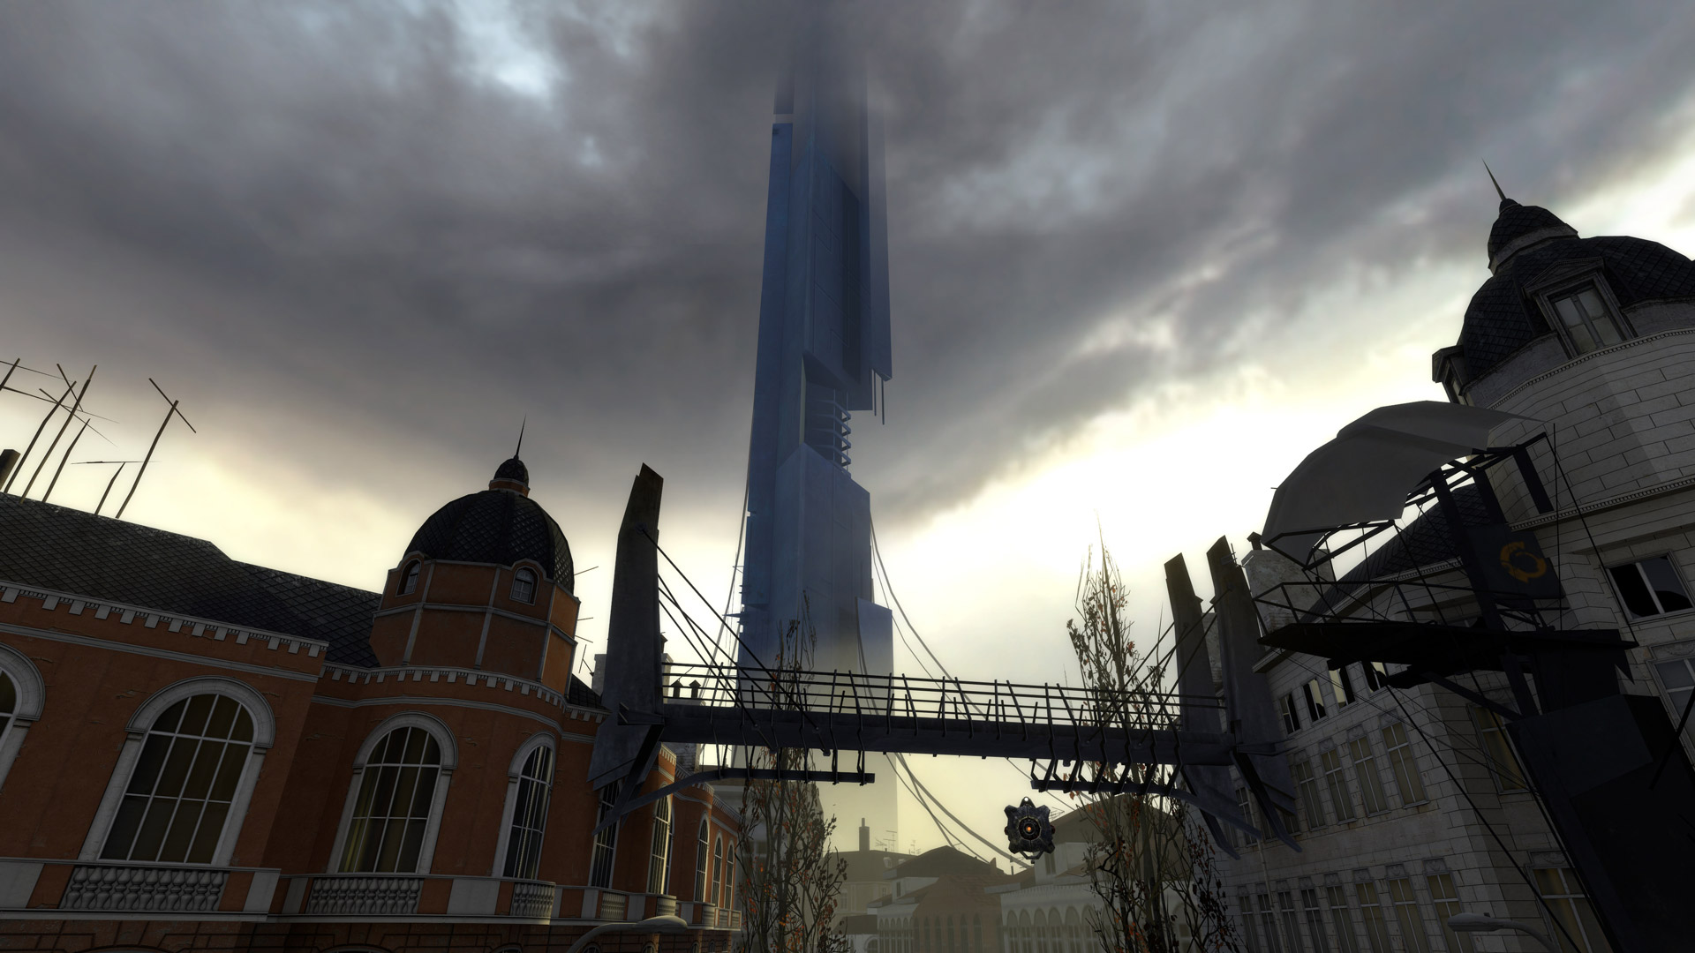
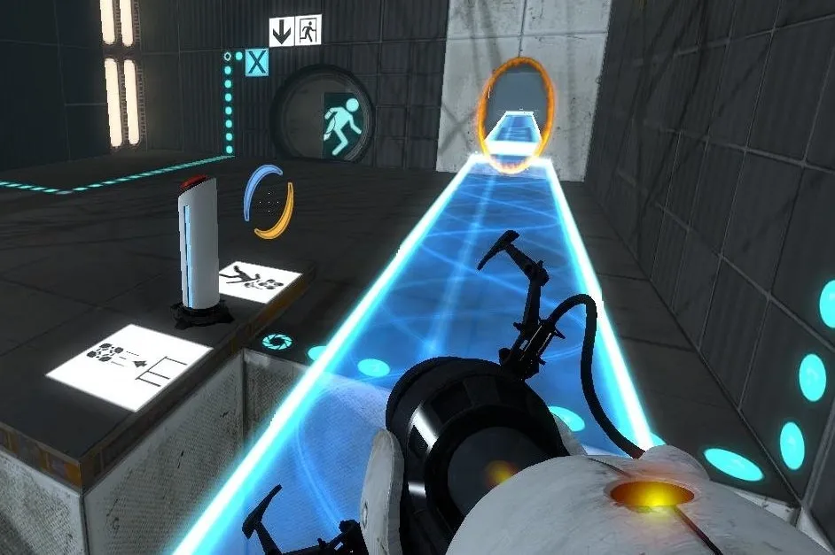
Focal Point
‘Half Life 2’ was a linear game of progression cunningly disguised as an open world game due to its clever design.
Have an established focal point for each part of your game.
“Half Life 2” © Valve
This can be an obvious focal point in the game world that you are working your way towards, or an exit point in the level that you need to reach.
This is not just for expansive, open world games either – Closed linear puzzle games such as ‘Portal 2’ make it very clear where the focal point of each level is.
Clear goals and objectives – How are you relaying this information to the player?
“Portal 2” © Valve

Slide 10
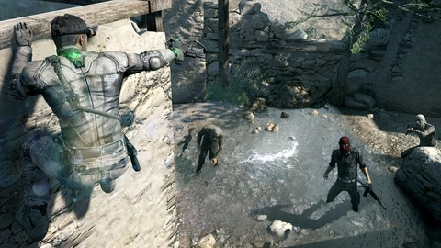
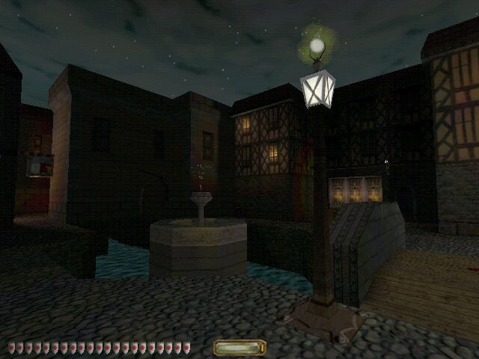

Anticipation
Designing elements in your game to create anticipation around an event – A good fit in stealth games like ‘Hitman’ and the Great-Grandfather of the them all: ‘Thief’, where you may be concealed in shadow waiting for that guard you have been watching to pass by.
How are these moments being related to the player? A visual cue? A sound cue?
The developers of ‘Thief’ came up with the concept of a ‘light gem’ at the bottom of the screen, which informed the player when they were concealed in shadow or in a well-lit area.
“Splinter Cell” © Ubisoft
“Thief 2: The Metal Age” © Looking Glass Studios
“Hitman 3” © IO Interactive

Slide 11
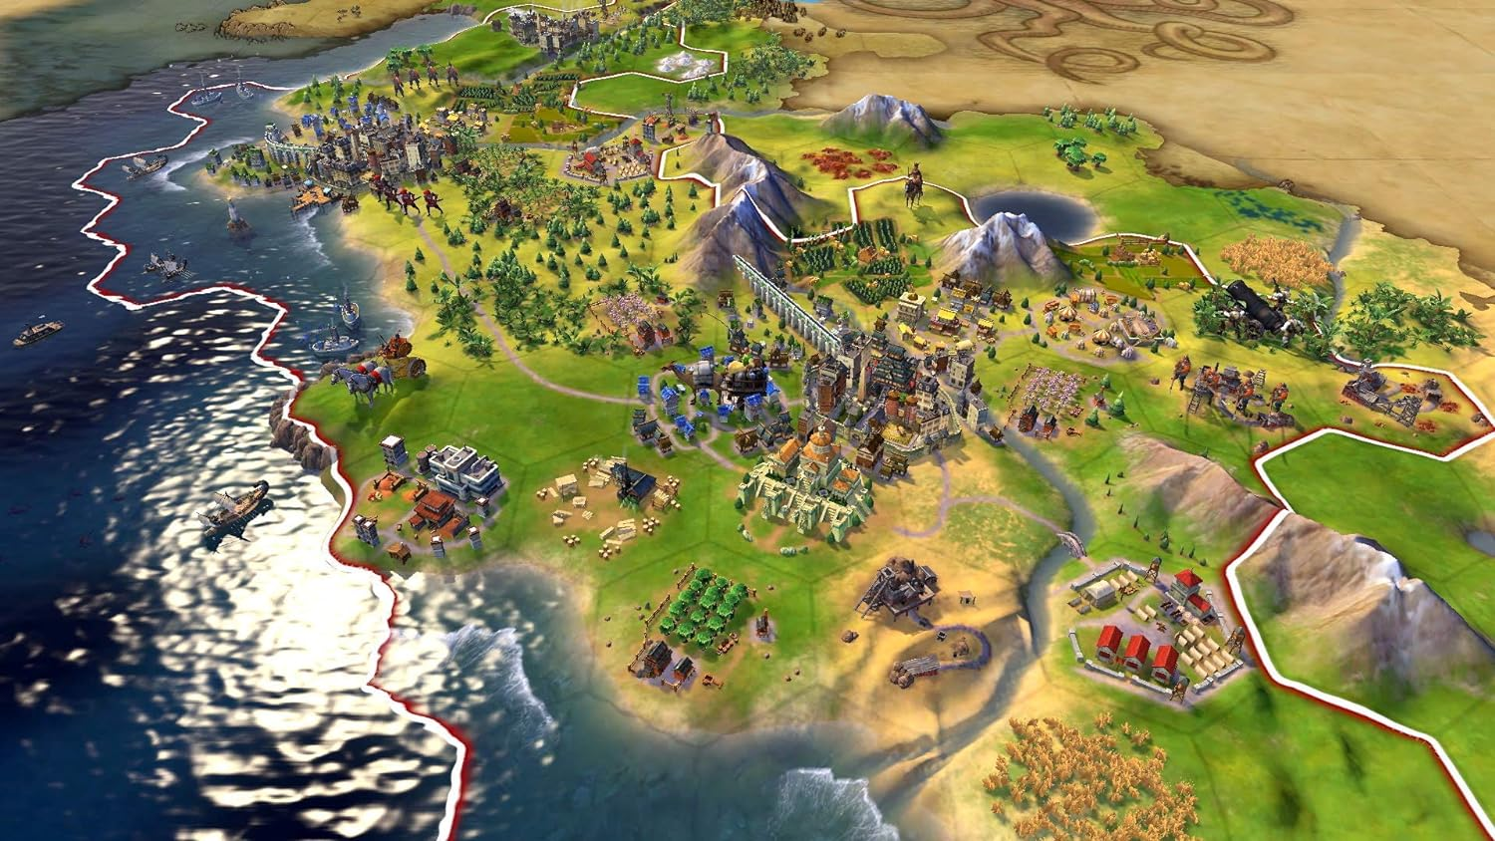
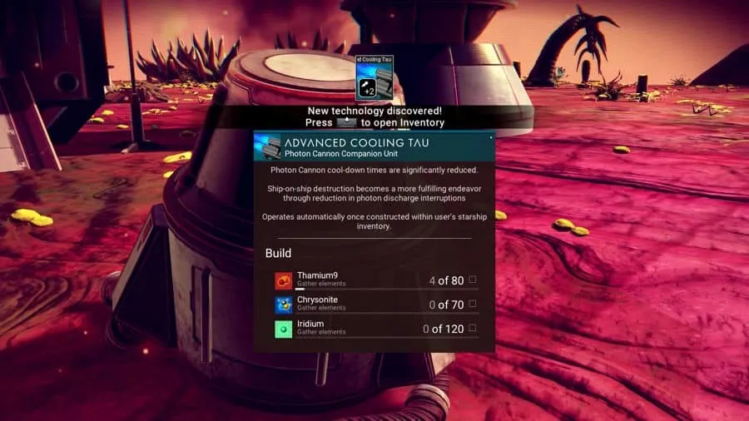
Announce Change - When important events occur, ensure the player is aware of them.
The map on ‘Civilisation VI’ can get very busy, so sound plays an important role in keeping the player informed of important events. Declarations of war, creation of units, and awarding of Great People are all related through their own unique sound.
The light gem in ‘Thief’ is purely a visual clue, which fits in with the silent and stealthy theme of the game. Also, because the diegetic sound in the game is crucial to the game-play, non-diegetic sounds are kept to a bare minimum.
“Sid Meier’s Civilisation VI” © Firaxis
‘No Man’s Sky’ uses very obvious on-screen prompts to alert the player to new technologies that are available to utilise. The style and pacing of your game will help to suggest which approach is more appropriate to adopt.
“No Man’s Sky” © Hello Games

Slide 12
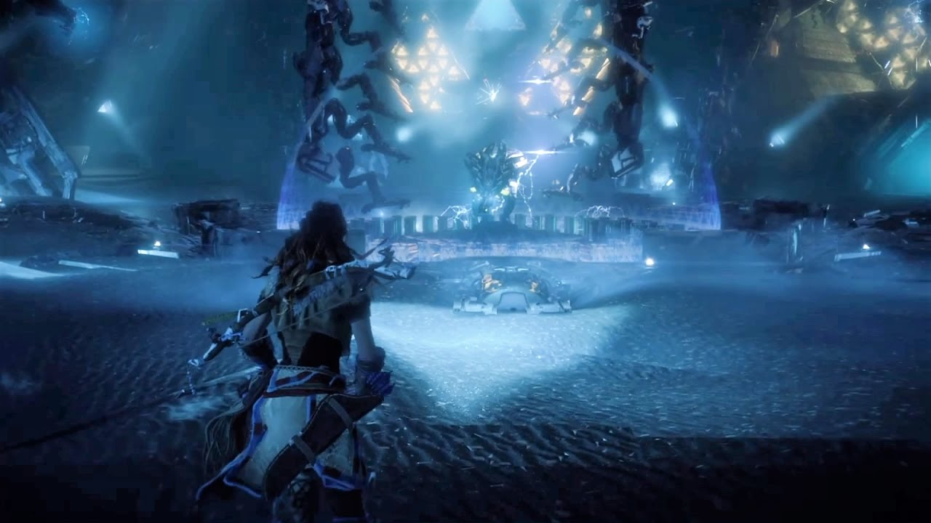
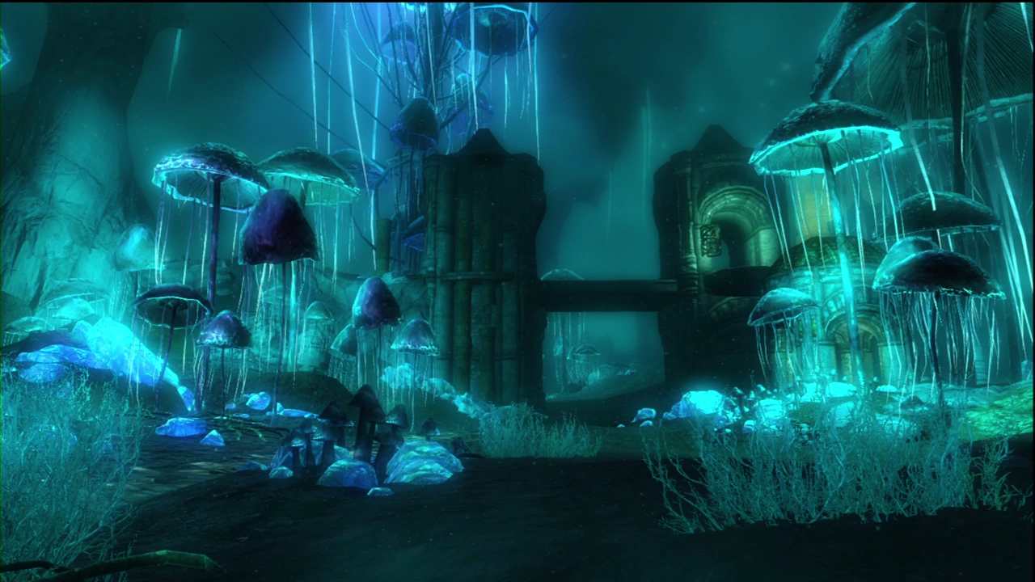
Pacing – Get it right!
Urgency vs Admiring the scenery
Unless your game is a Bullet-Hell on-rails shooter, you might be inclined to give your player a little breather now and then and allow them to appreciate the hard work of the artists and level designers; and to learn more about the game world and the lore.
From the perspective of immersion and player experience, allowing our player some respite after a particularly tough boss battle or a challenging situation can create the illusion of having been through something BIG, despite the abstraction of it having happened as part of the in-game narrative.
“Horizon Zero Dawn” © Guerrilla Games
“Elder Scrolls V: Skyrim” © Bethesda Softworks

Slide 13
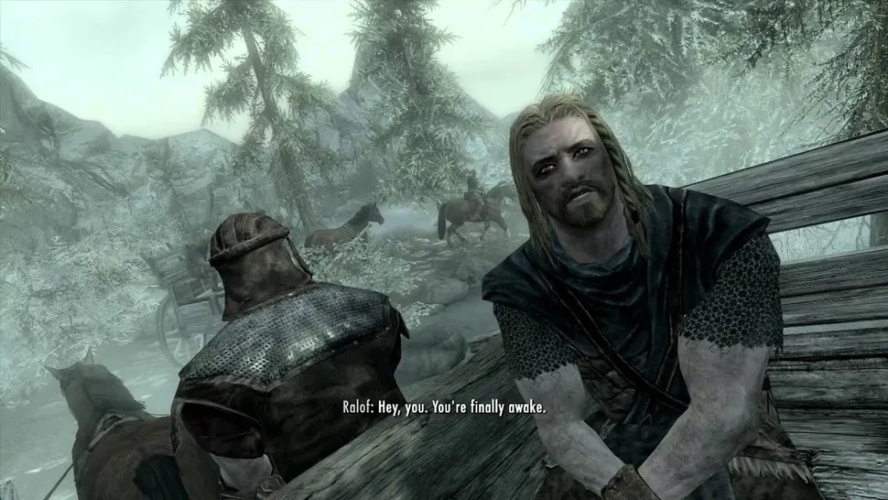
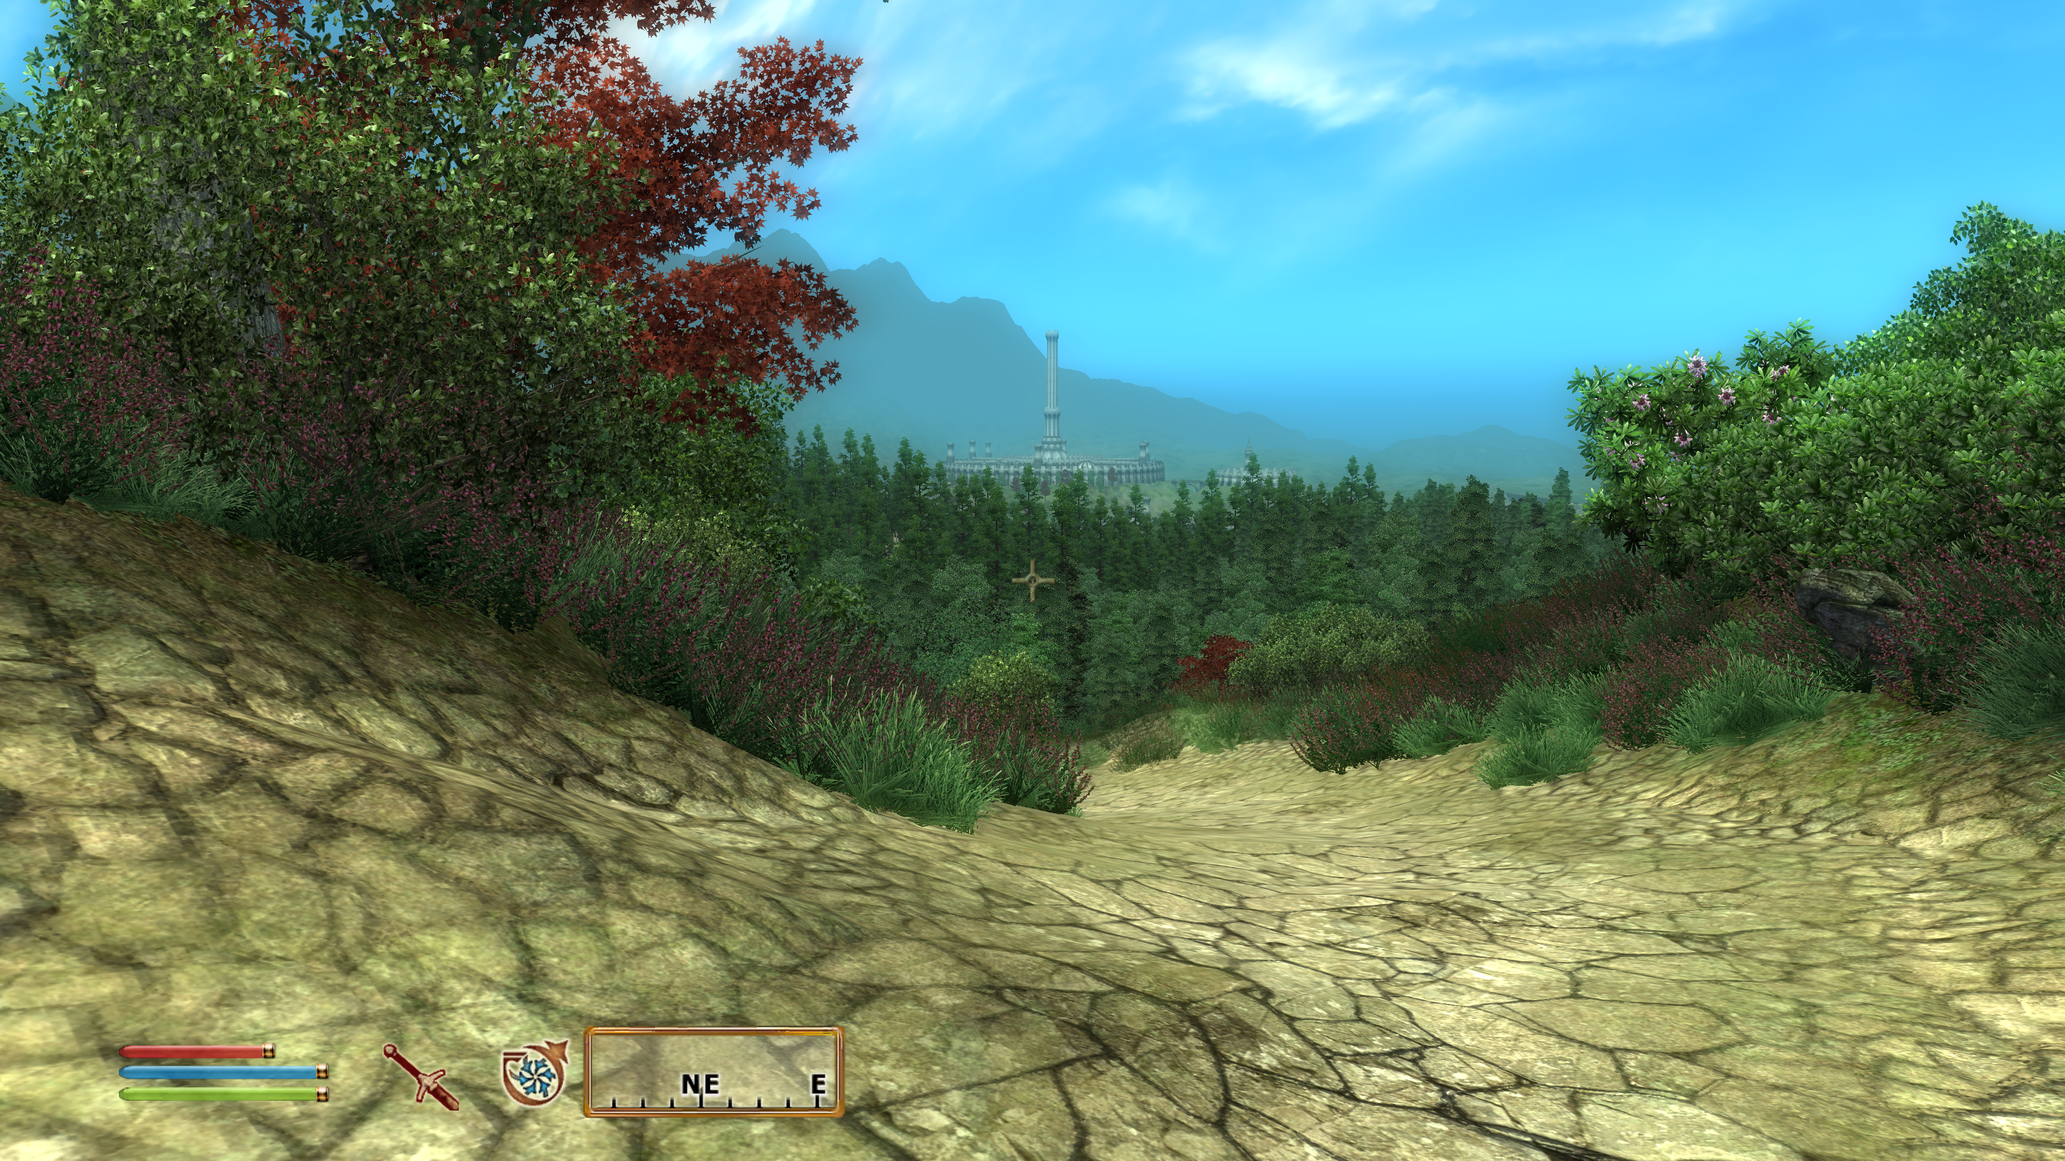
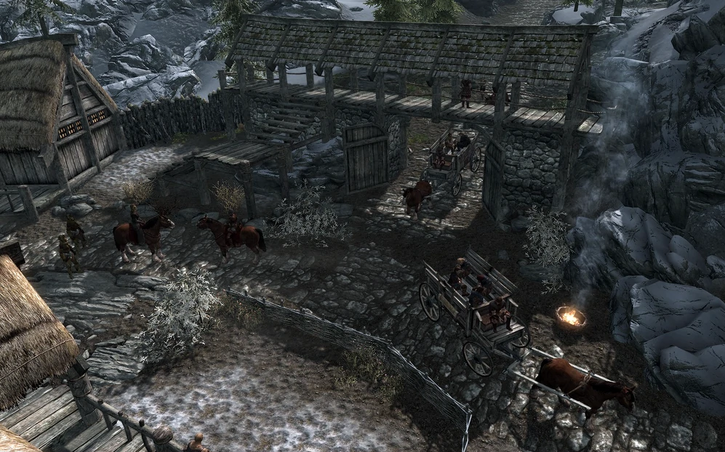
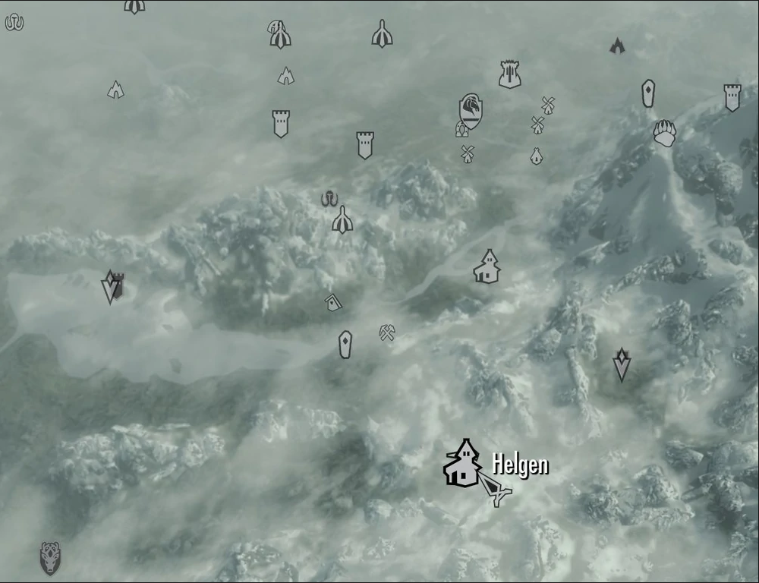
Hey you, you’re finally awake.
Bethesda have a pattern when it comes to pacing, particularly post-tutorial.
In ‘Elder Scrolls VI: Oblivion’, ‘Elder Scrolls V: Skyrim’, and ‘Starfield’ the game begins either underground or in an enclosed space and remains there for the duration of the opening tutorial. Once you have had a chance to practice the core mechanics sufficiently, you are ejected into the massive open world.
This shift really helps sell the idea that you are now free to explore and go anywhere you choose, after the rather linear and confined opening.
“Elder Scrolls IV: Oblivion” ©Bethesda Softworks
“Elder Scrolls V: Skyrim” ©Bethesda Softworks

Slide 14
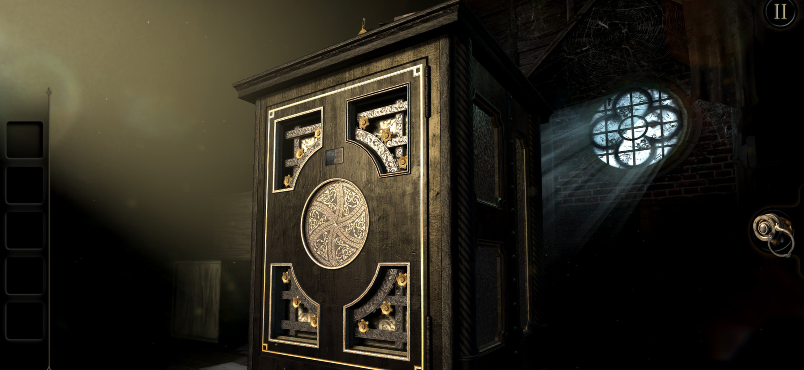
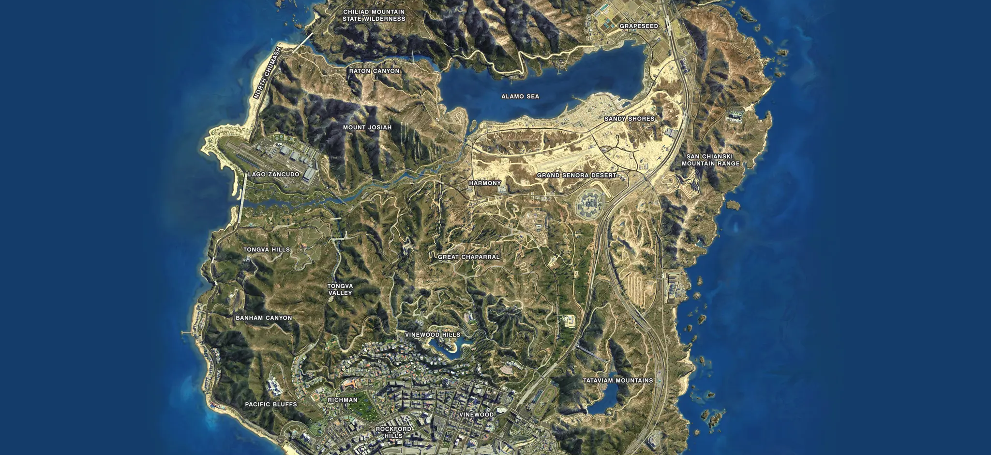
Spacing – Get that right too!
Avoid environments that are too small or unnecessarily large!
‘The Room’ is set within one environment, whereas the ‘GTA’ games encompass entire cities. But these settings work ideally for those kinds of games.
Each environment is ideal for the gameplay, and also the size of the team making it! It took over 1000 people to make GTA V (French, 2013), The Room was made by just 2 people (Dredge, 2013).
“The Room” © Fireproof Studios
“GTA V” © Rockstar North

Slide 15
Model Believable Events and Behaviours (Unless you have a good reason not to!)
Actions in the game should fit the expectations of the player, based on their knowledge of those events – Which may be subconscious.
Example – Explosions cause things to fly apart, objects fall in accordance with the laws of gravity.
Model events to react to the setting and the narrative you have created, and if they change for any reason, make sure that you convey this to the player.
Poor AI can be immersion-breaking.
When a dragon or vampires attack a village in Skyrim, the villagers run indoors but the town guards start to fight back. The villagers are weaker and not well-armed, so this would make sense... It would be inconvenient, if not supported by the game mechanics, if vampires and dragons were killing off important NPCs and traders during these attacks and locking the players progress.

Slide 16
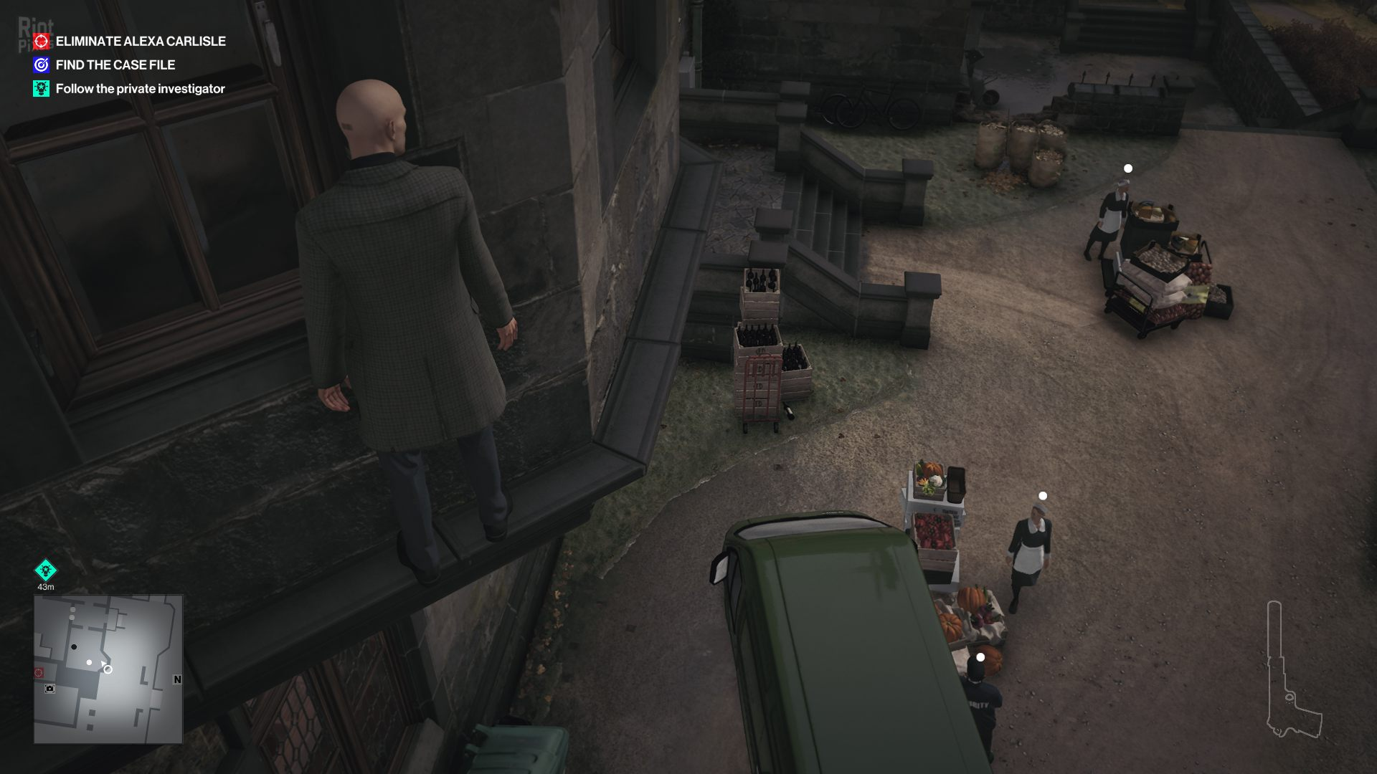
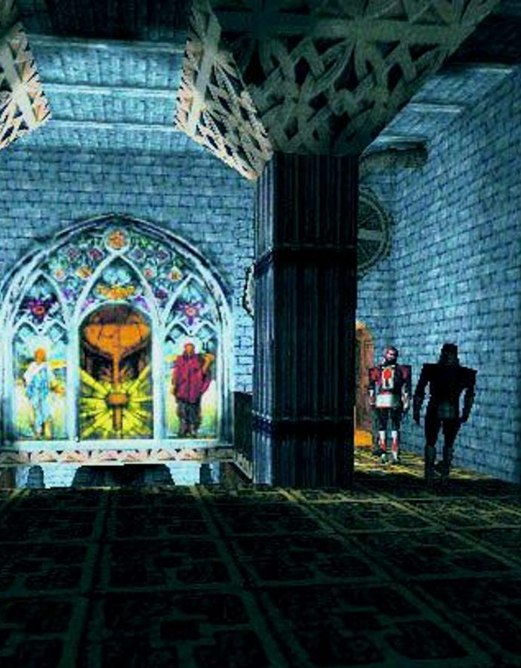
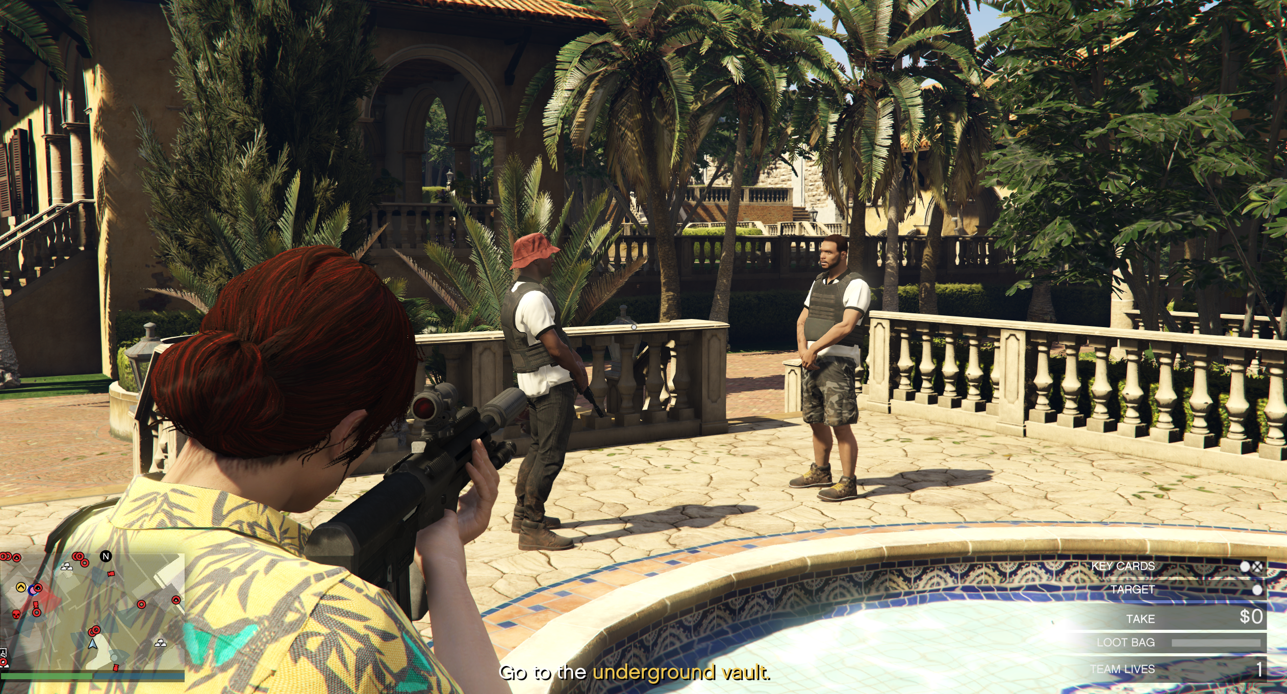
But... does AI that is too realistic make for good gameplay?
In the stealth genre, avoiding patrolling guards and cameras is a given, with guards generally adhering to set routes and only breaking the pattern if they come suspicious of your presence.
This behaviour can seem unrealistic, especially if you’re in an NPC’s face but just outside their cone of vision!
There is a balance at play here, between making the NPCs seem real, but also creating an achievable experience for the player. Testing is important for finding this balance.
“Hitman 3” © IO Interactive
“GTA Online” © Rockstar North
“Thief 2: The Metal Age” © Looking Glass Studios

Slide 17
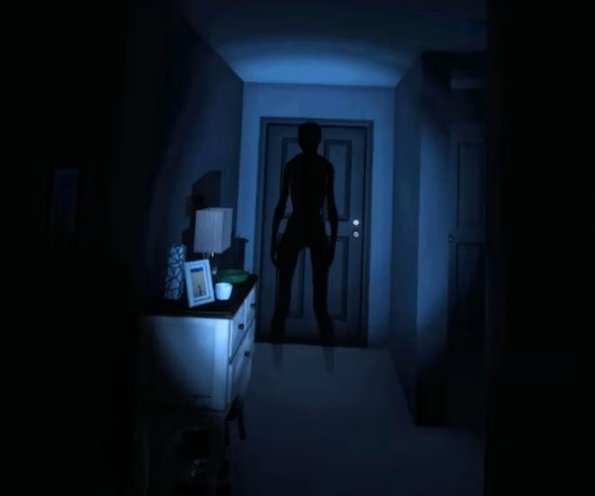

Use sound appropriately – And don’t make it an after-thought!
Diegetic sound – Sound which happens in the game and is registered by the characters in the game.
Non-Diegetic sound – Sound which happens in the game but is there solely for the benefit of the player.
Phasmophobia (Kinetic) makes sound pivotal to the game, from setting the atmosphere as soon as you enter the house, to providing clues to the location of the ghost. All sound in the game is diegetic, down to the ghost being able to hear you talking to your teammates.
Super Mario Bros (Nintendo) is all non-diegetic sound. The music playing during the game, the sound when Mario jumps, collects pick-ups… Every sound is there to inform the player that they have successfully performed an action, but there are no sounds directly relating to the game-world.

Slide 18
References
Dredge, S. (2013) Apple award sends iPad game The Room soaring past 1m sales. The Guardian. Available at: https://www.theguardian.com/technology/appsblog/2013/jan/23/the-room-iphone-ipad-1m-sales [Accessed 18 September 2024]
French, M. (2013) Inside Rockstar North Part 2: The Studio. Develop Online. Available at: http://www.develop-online.net/studio-profile/inside-rockstar-north-part-2-the-studio/0184061 [Accessed 18 September 2024]
Hooper, R. (2016) The man who made ‘the worst video game in history’. BBC News. Available at: https://www.bbc.co.uk/news/magazine-35560458. [Accessed 30 July 2024]
Meier, S. (2020) Sid Meier’s Memoir! A Life in Computer Games. Norton: New York.
Schell, J. (2020) The Art of Game Design: A Book of Lenses. 3rd Edition. CRC Press:FL

